Slide 1


Effective Strategies to Meet the Unique Needs
of Justice Involved Women
Developed February 2016

Slide 2

Women are entering the criminal justice system at an alarming rate.
FACT: Since 1985, the number of women in prison has increased at a faster rate than men, 404% as compared to 209% by men
Over 2 million women were arrested in the United States in 2013.
As of 2013, approximately 1.2 million women were under the authority of the criminal justice system, with the majority under probation supervision.
Women in local jails has increased 44 percent between 2000 and 2013.
Women in the Criminal Justice System: Briefing Sheets, The Sentencing Project, 2007
Crime in the United States 2013, FBI, 2014
Correctional Populations in the United States, 2013, Bureau of Justice Statistics, 2014

Slide 3
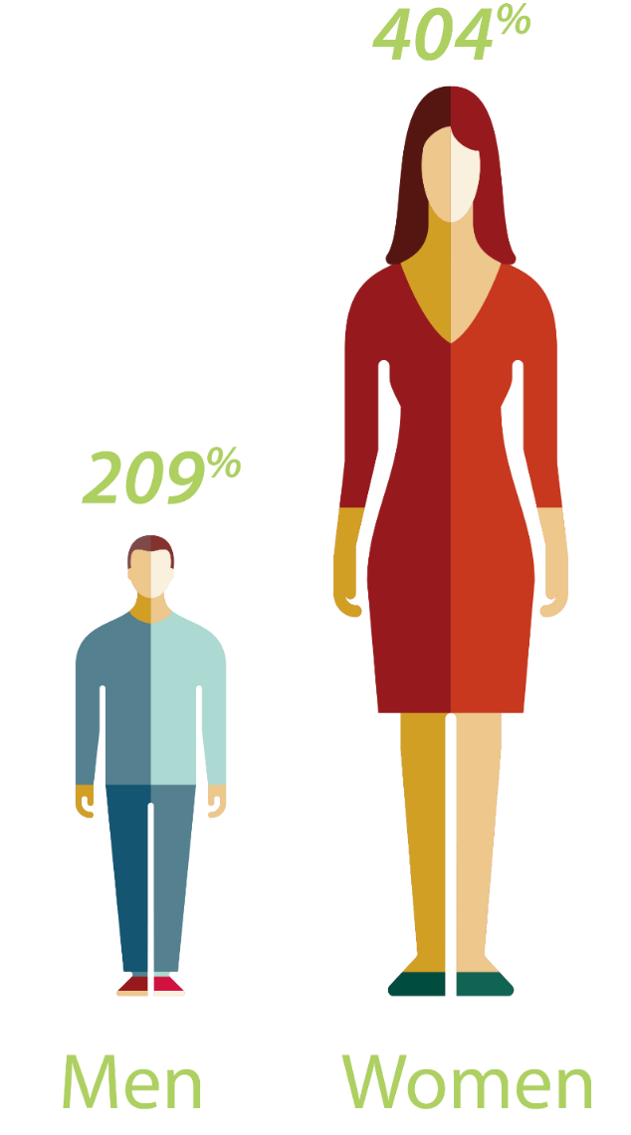
Since 1985, the number
of women in prison has increased at a faster
rate than men
Women in the Criminal Justice System: Briefing Sheets, The Sentencing Project, 2007

Slide 4
Who are
JUSTICE INVOLVED WOMEN?

Slide 5
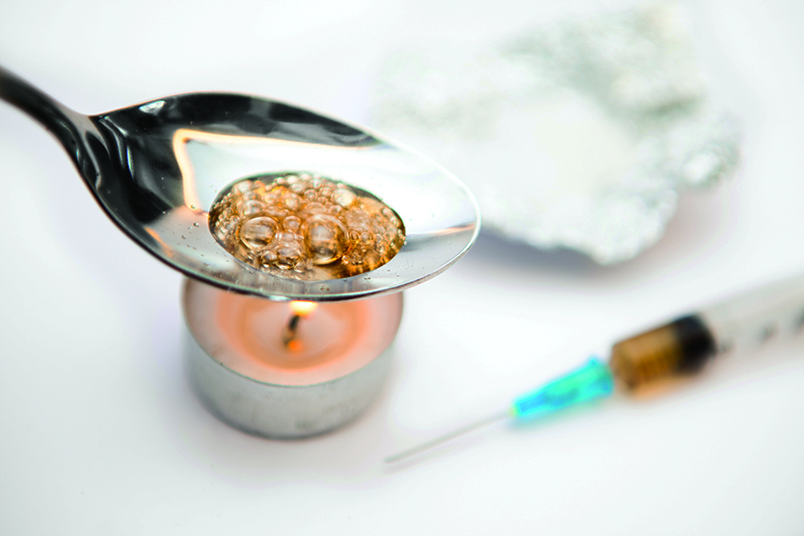


CRIME CONVICTIONS
Most justice involved women are arrested for non-violent crimes
26%
3%
20%
Drug Crimes
Violent Crimes
Property Crimes
Percentage of all arrests of women in 2013
Prisoners in 2013, Bureau of Justice Statistics, Sept. 2014

Slide 6





LIFE CIRCUMSTANCES
Many justice involved women share similar life circumstances that are unique from men
77-98%
of incarcerated women have experienced trauma (including interpersonal violence and/or physical/sexual abuse)
73%
of women in prison reported
a mental health problem
7
6
60%
of women in prison reported using drugs just prior to their offense (compared to 56% of men)
Up to half
of women who are incarcerated were homeless in the month before incarceration
8
9
Looking Beneath the Surface: The Nature of Incarcerated Women’s Experiences of Interpersonal Violence, Treatment Needs, and Mental Health, Heath, Nicole M., April Fritch, Shannon M. Lynch, Feminist Criminology, Published April 2012, Revised Oct. 2012
Mental Health Problems of Prison and Jail Inmates, Bureau of Justice Statistics, Published Sept. 2006, Revised Dec. 2006
Drug Use and Dependence, State and Federal Prisoners, 2004, Bureau of Justice Statistics, Published 2006, Revised 2007
Gender-Responsive Strategies for Women Offenders, National Institute of Corrections, 2010

Slide 7
DEMOGRAPHICS
49%
22%
17%
Race/Ethnicity
In 2013, percentage of women
in state or federal prisons
White
Black
Hispanic
60%
37%
30%
Employment
and Income
Not employed full-time
Income under
$600/ month
Received welfare
benefits
Prisoners in 2013, Bureau of Justice Statistics, Sept. 2014
Women in the Criminal Justice System: Briefing Sheets, The Sentencing Project, 2007

Slide 8

EDUCATION
42%
of women in state prisons
have not completed high school
Education and Correctional Populations, Bureau of Justice Statistics, Published Jan. 2003, Revises April 2003

Slide 9

Maternal Incarceration Significantly Impacts
Children
147,700 children had a mother in prison in 2007,
up from 131% from 1991
64% of mothers in state prison lived with at least
one of their children just prior to imprisonment
Parents in Prison and Their Minor Children, Bureau of Justice Statistics, Published 2008, Revised 2010

Slide 10
Working With
JUSTICE INVOLVED WOMEN

Slide 11





Utilize a Multi-Faceted APPROACH
Relational
Develop policies, practices, and programs that are relational and promote healthy connections
Strengths-Based
Create an environment based on
safety, respect, and dignity
Trauma-Informed
Address substance abuse, trauma,
and mental health issues
Culturally Competent
Provide women with opportunities
to improve their socioeconomic conditions
Holistic
Establish a system of community supervision and reentry with comprehensive, collaborative services
The Five CORE Practice Areas of Gender Responsiveness, CORE Associates

Slide 12





Pregnant Prisoners
Consider the needs of pregnant women
in correctional facilities and provide special privileges
Limited or non-use of restraints
Bottom bunk assignments and light work duty
Additional snacks/milk to meet their nutritional needs
Ongoing obstetric appointments, prenatal vitamins, social support and counseling, birth education, and transportation to and from the hospital
Improving Health Care for Incarcerated Women, National Resource Center on Justice Involved Women, 2015
National Task Force on the Use of Restraints with Pregnant Women under Correctional Custody, U.S. Department of Health and Human Services, 2012

Slide 13




Hurdles to Success
Whether during pretrial, incarceration or parole, criminal justice practitioners and their partners can help justice involved women overcome hurdles and navigate their way to success.
Housing
Financial
Medical
Education & Training
Women on Probation and Parole: Access to Crime Reducing Benefits and Programs, Cobbina, Jennifer E, Deborah A. Kashy, Merry Morash, Sandi W. Smith

Slide 14
Gender-specific Responses for COURTS

Slide 15
Determine Unique Needs and Risks during Pretrial and Sentencing
Abuse
Substance Abuse
Criminal History
PRETRIAL FAILURES
Employment
“I see over and over again the negative influences on women. Women [in my courtroom] are unemployed and underemployed. They have co-occurring disorders and mental health issues. These all impact their becoming involved in the system and having different risk and needs than men.”
— Judge Michael A. Schumacher, Eau Claire County,
Wisconsin Circuit Court
Mental Health
Family Support
Homelessness
Implementing Gender-Informed Strategies at the Pretrial Stage: Research to Practice, 2015

Slide 16



CONSIDER ALTERNATIVES TO INCARCERATION
Drug rehabilitation
treatments and counseling
Mental health assessments
and services
Home-based
incarceration
alternatives
Innovator Profile: JusticeHome, Women’s Prison Association

Slide 17


Develop Women-Centric PROBLEM SOLVING &
TREATMENT COURTS/DOCKETS
Courts/dockets and treatment groups
should be women-only
Offer individual assessments
Provide highly focused services
  Cognitive behavioral treatment
  Trauma services
Maintain contact with “treatment team”
  Judge
  District Attorney
  Court Coordinator
  Jail/work release captain
  Treatment provider
Innovator Profile: Eau Claire County, WI, Alternatives to Incarcerating Mothers (AIM) Court, National Resource Center on Justice Involved Women, 2014

Slide 18
Gender-specific Responses
For INSTITUTIONAL CORRECTIONS

Slide 19

Work With WOMEN In A GENDER-INFORMED Manner
to ENHANCE SAFETY and SECURITY, and HELP
^{WOMEN BECOME MORE SUCCESSFUL}
Case Study:
The Women’s Village
Offer individual assessments
Provide highly focused services
  Cognitive behavioral treatment
  Trauma services
Maintain contact with “treatment team”
  Judge
  District Attorney
  Court Coordinator
  Jail/work release captain
  Treatment provider
After implementing a gender-responsive program in the Washington Corrections Center for Women called “the Women’s Village,” the warden reported witnessing benefits such as increased offender accountability, women with enhanced self-esteem and a greater sense of civic responsibility, less tension between offenders and staff, and an increase in participation in classes and programming.
Innovator Profile: Eau Claire County, WI, Alternatives to Incarcerating Mothers (AIM) Court, National Resource Center on Justice Involved Women, 2014
Innovators: Lynn Bissonnette, Massachusetts Correctional Institution- Framingham, National Resource Center on Justice Involved Women

Slide 20

Interact with women in a more gender-informed way
Anticipate and explore reasons for her actions
Acknowledge what might she be feeling
Validate her experience
Reflect on what you hear her saying
Reflect her position
Reflect/explore relevant parameters/limits
Brainstorm solutions with her
Stay positive and encourage her to pick an option and then remain involved and supportive by checking in with her
Using the Relational Language Skill Steps to Engage, Connect and Collaborate with Girls and Women, CORE Associates, Inc.

Slide 21
Trauma-informed Approaches
Can Improve Safety and Reduce Stress
One year after adopting a trauma-informed approach, the Massachusetts Correctional Institution for Women at Framingham saw a significant reduction in:
"Many women do not even recognize the role that past trauma has played in their pathway to crime. Our staff must recognize [the importance of trauma] before we can expect the women to."
— Jane Parnell, Former Superintendent, WCCW
-62%
inmate-on-staff assaults
-54%
inmate-on-inmate assaults
-46%
inmate-on-inmate fights
  MA Correctional Institution for Women experience and results
  Innovators: Lynn Bissonnette, Massachusetts Correctional Institution- Framingham,
  National Resource Center on Justice Involved Women
  Innovator: Superintendent Jane Parnell and Washing Corrections Center for Women: Progress in Implementing Gender-Responsive Action Plan/Women's Village Concept, National Resource Center on Justice Involved Women, 2013

Slide 22





SUPPORT STRONG FAMILIAL RELATIONSHIPS
Encourage visits and phone calls
Offer regular video visitations
Provide opportunities for
mother-child bonding
Facilitate transportation for families
Provide child-friendly visitation areas
Childhood Disrupted: Understanding the Features and Effects of Maternal Incarceration, Volunteers of America, 2010

Slide 23
Gender-specific Responses for COMMUNITY CORRECTIONS

Slide 24
FOCUS ON NEEDS FOR
COMMUNITY REENTRY AND SUCCESS
Ability to Support Children
Safe Housing
Livable Wage
Meeting the Needs of Women in California's County Justice Systems, Californians for Safety and Justice, Barbara E. Bloom, 2015

Slide 25

Be Active in
SUPPORTING GOALS
Consider the important role community corrections and supervision staff play in supporting women to achieve their goals and remain crime free.
Demonstrate empathy and respect, while maintaining
professional boundaries
Focus on strengths and challenges, and provide encouragement and feedback
CASE STUDY: Probation Officers participating in the Women Offender Case Management Model (WOCMM) – now called Collaborative Casework-Women (CCW) – in Connecticut had more successful caseloads when they focused on the women’s strengths and challenges and provided encouragement and feedback.
The Truths that Matter When Working with Justice Involved Women, 2012
Women Offender Case Management Model: Outcome Evaluation, National Institute of Corrections and State of Connecticut Judicial Branch/Court Services Division, 2010

Slide 26
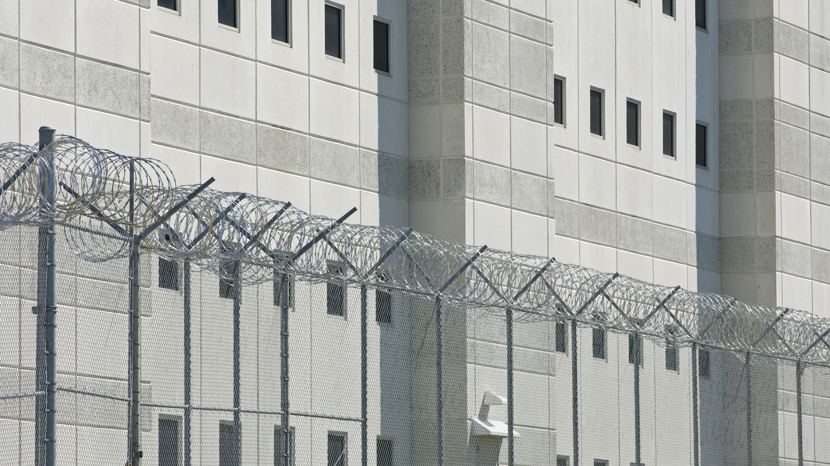
Address Individual’s Unique Needs
Partner with Community Service Providers
Improved
Outcomes
Community
Corrections Staff
Mental Health
Providers
Probation and Parole Authorities
Substance Abuse Counseling
Gender-Responsive Strategies for Women Offenders, National Institute of Corrections, 2005

Slide 27
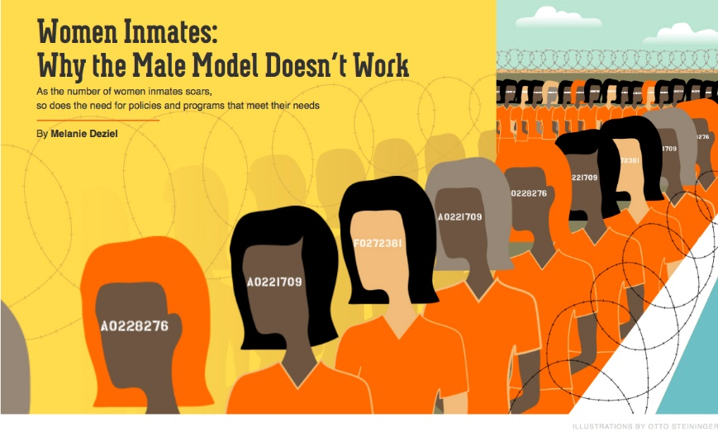
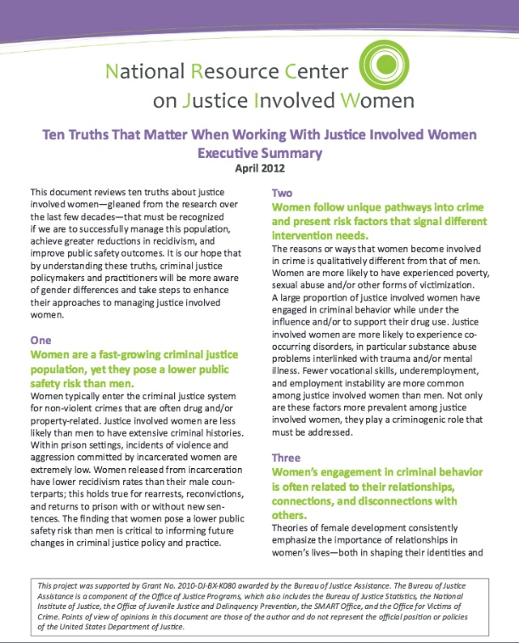
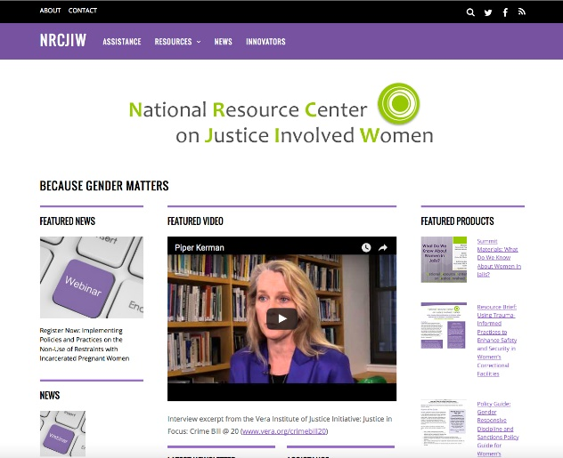
Take advantage of
available resources.
NRCJIW provides resources and tools to support practitioners within courts, correctional facilities and community settings to achieve successful outcomes with justice involved women.
To learn more, visit
www.cjinvolvedwomen.org

Slide 28

THANK YOU
National Resource Center on Justice Involved Women
NRCJIW provides resources and tools to support practitioners within courts, correctional facilities and community settings to achieve successful outcomes with justice involved women.
NRCJIW
Address
Phone
Website
8605 Cameron Street,
Suite 514
Silver Spring, MD 20910
(301) 589-9383
www.cjinvolvedwomen.org
The NRCJIW is funded by the U.S. Department of Justice, Office of Justice Programs, Bureau of Justice Assistance in partnership with the National Institute of Corrections

Slide 29
Effective Strategies to Meet the Unique Needs
of Justice Involved Women
Developed February 2016
This project was supported by Grant No. 2010-DJ-BX-K080 awarded by the Bureau of Justice Assistance. The Bureau of Justice Assistance is a component of the Office of Justice Programs, which also includes the Bureau of Justice Statistics, the National Institute of Justice, the Office of Juvenile Justice and Delinquency Prevention, the SMART Office, and the Office for Victims of Crime. Points of view or opinions in this document are those of the author and do not necessarily represent the official position or policies of the U.S. Department of Justice.

